Slide 1
CSYE 7374
Design Patterns
Notes:
1.001

Slide 2
Prototype Pattern
Daniel Peters
d.peters@neu.edu

Slide 3
Lecture
UML
Design Patterns:
Gang of Four (GoF)
Prototype Pattern

Slide 4
Relationships
5/21/2020
Association
Aggregation
“Has-A”
Composition
“Has-A”
Generalization
Inheritance
“Is-A”

Slide 5
Association Relationship
5/21/2020
Association: Has-A Relationship
Aggregation
Weak association: linked but independent objects
possessed object can survive after possessing object
Line with open arrowhead outline
Composition
Strong association: linked objects are dependent
possessed object is destroyed along with possessing object
Line with solid filled-in arrowhead

Slide 6
Aggregation Association Relationship
1..*
1
10..*
1
1
1
6/12/2020
Weak Independent Aggregation Association
Teacher Classroom
Student School
Driver Automobile
Teachers can continue to exist without Classroom
Student existence independent of School
Driver can get another Automobile

Slide 7
Composition Association Relationship
2
1
1
1
1
1
6/12/2020
Strong Dependent Composition Association
Eyes Body
State Context
AutoState Automobile
The Automobile State (AutoState) is dependent on existence of the Automobile

Slide 8
Relationships
9/7/2015
Generalization
Parent
Child

Slide 9
UML Class Diagram
Class
Attributes
Operations
9/7/2015

Slide 10
UML Class Diagram
ClassName
- private
- Attribute1 : int
- Attribute2 : String
+ public
+ Operation1() : int
+ Operation2(int) : void
9/7/2015

Slide 11
Person Class Diagram
Person
- age : int
- name : String
+ setAge(int) : void
+ getAge() : int
+ setName(String) : void
+ getName() : String
Employee
Student
- hours: int
- grade : int
+ setHours(int) : void
+ getHours() : int
+ setGrade(int) : void
+ getGrade() : int
9/7/2015

Slide 12
Design Patterns
Gang of Four (GoF) Book
Design Patterns
Elements of Reusable Object-Oriented Software
by Erich Gamma, Richard Helm, Ralph Johnson John Vlissides
ISBN-10: 0201633612
ISBN-13: 9780201633610

Slide 13
Creational Design Patterns
Abstracts the instantiation (object creation) process
Replaces class constructor
Supports system independence from object creation, composition and representation details
Inheritance and Object Composition
Subclasses are instantiated
New Objects are composed
Gang of Four (GoF) Book

Slide 14
Prototype Design Pattern
Prototype Pattern is a Creational Pattern in GoF Design Patterns Book:
“Specify the kinds of objects to create using a prototypical instance and create new objects by copying this prototype."
Uses object composition over subclassing
Reduces overall number of classes
Creation by Cloning
Gang of Four (GoF) Book

Slide 15
Prototype Design Pattern
Anatomy of a Design Pattern
Who (are): Constituent Components (parts)
What (happens): Operational
Where (useful): Scenarios
Why (design) Rationale
When (used): Benefits

Slide 16
Prototype Design Pattern
Who:
Constituent components, roles or parts participating in the deployment and use of the Prototype pattern
Client clones and uses a specific Prototype
ONE Client subclass modified to use Prototypes
Dynamic Run-time decision for object creation
Prototype API: clone() method
Specifies clone() for prototype creation
Prototype Implementation
Implements clone()
Uses unchanged Legacy class

Slide 17
Prototype Design Pattern
What:
A brief description of what happens with the use of the Prototype pattern
Modified Client subclass clones a specific Prototype
Dynamic Run-time decision for object creation
Client uses modified subclass, which now uses prototypes
Inter-operability while maintaining loose coupling

Slide 18
Prototype Design Pattern
Where:
A list of suitable scenarios for the use of the Prototype pattern
In a Loosely coupled system where (1 or more of the following):
Run-Time configuration: created classes are specified dynamically at run-time.
Class Reduction: many sub-classes would otherwise be created
Object State: class instances have only a few variations (combinations) in state

Slide 19
Prototype Design Pattern
Why:
A brief description of rationale behind the design of the Prototype pattern
Third party Client software need to work with non-client Legacy classes
Run-time decision on which classes create objects
Client uses ONE modified Client sub-class
Modified Client sub-class clones and uses prototypes to hide and use Legacy classes
Modified Client subclass IS-A Client
Legacy Inter-operability AND loose coupling

Slide 20
Prototype Design Pattern
When:
A brief description of the benefits obtained when using the Prototype pattern
Abstraction: hides object creation
Interoperability: allows use of other classes without modification.
Inter-operability achieved while maintaining loose coupling
Dynamic run-time object creation
Create new objects by composition
Specifying object state

Slide 21
Prototype Pattern
6/12/2020
Third party Client Tooling package has a Toolclass and subclasses derived from Toolclass
Required to use tooling package software, but with our non-client classes.
Modify ONE Client sub-class
IS-A Client for use with Client Tooling package
Parameterized for cloning and using Legacy prototypes with Client Tooling package

Slide 22
Prototype Pattern
6/12/2020
Use a Prototype:
Prototype: Clone ONE tooling subclass
Avoids Subclassing which would require creating many subclasses
Modify to initialize with one Prototype parameter
Include a Clone my Prototype method
Use object composition:
Initialize object with it's own specific Prototype
Many objects each set with a unique Prototype

Slide 23
Prototype Pattern
6/12/2020
Class reduction
No need to create a new Tooling Subclass for each of our own classes
Only create One new Tooling Subclass as Prototype
Tooling class can use Prototype because it Is-A Tooling subclass
New Tooling Subclass (Prototype) is parameterized to accept (as object instance data)
a Prototype object created from one of our own classes
a clone my prototype method

Slide 24
Prototype Pattern
6/12/2020
One Prototype subclass
IS-A
Derived from Tooling Subclass
Inherits all Tooling capabilities and characteristics
Has-A
Unique specific Prototype object
Instantiated from our own class
Clone my prototype method

Slide 25
Summary: Prototype Pattern
Creation by Cloning
Creational Pattern

Slide 26
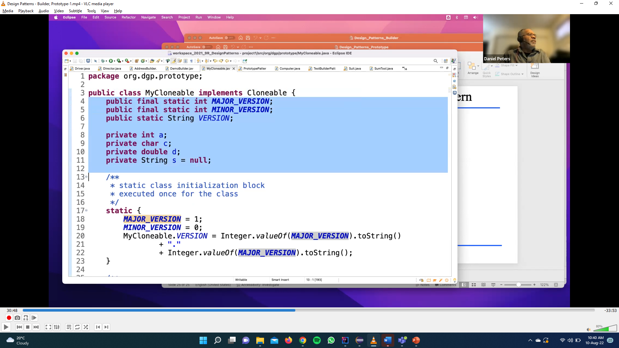
Prototype Code-2

Slide 27
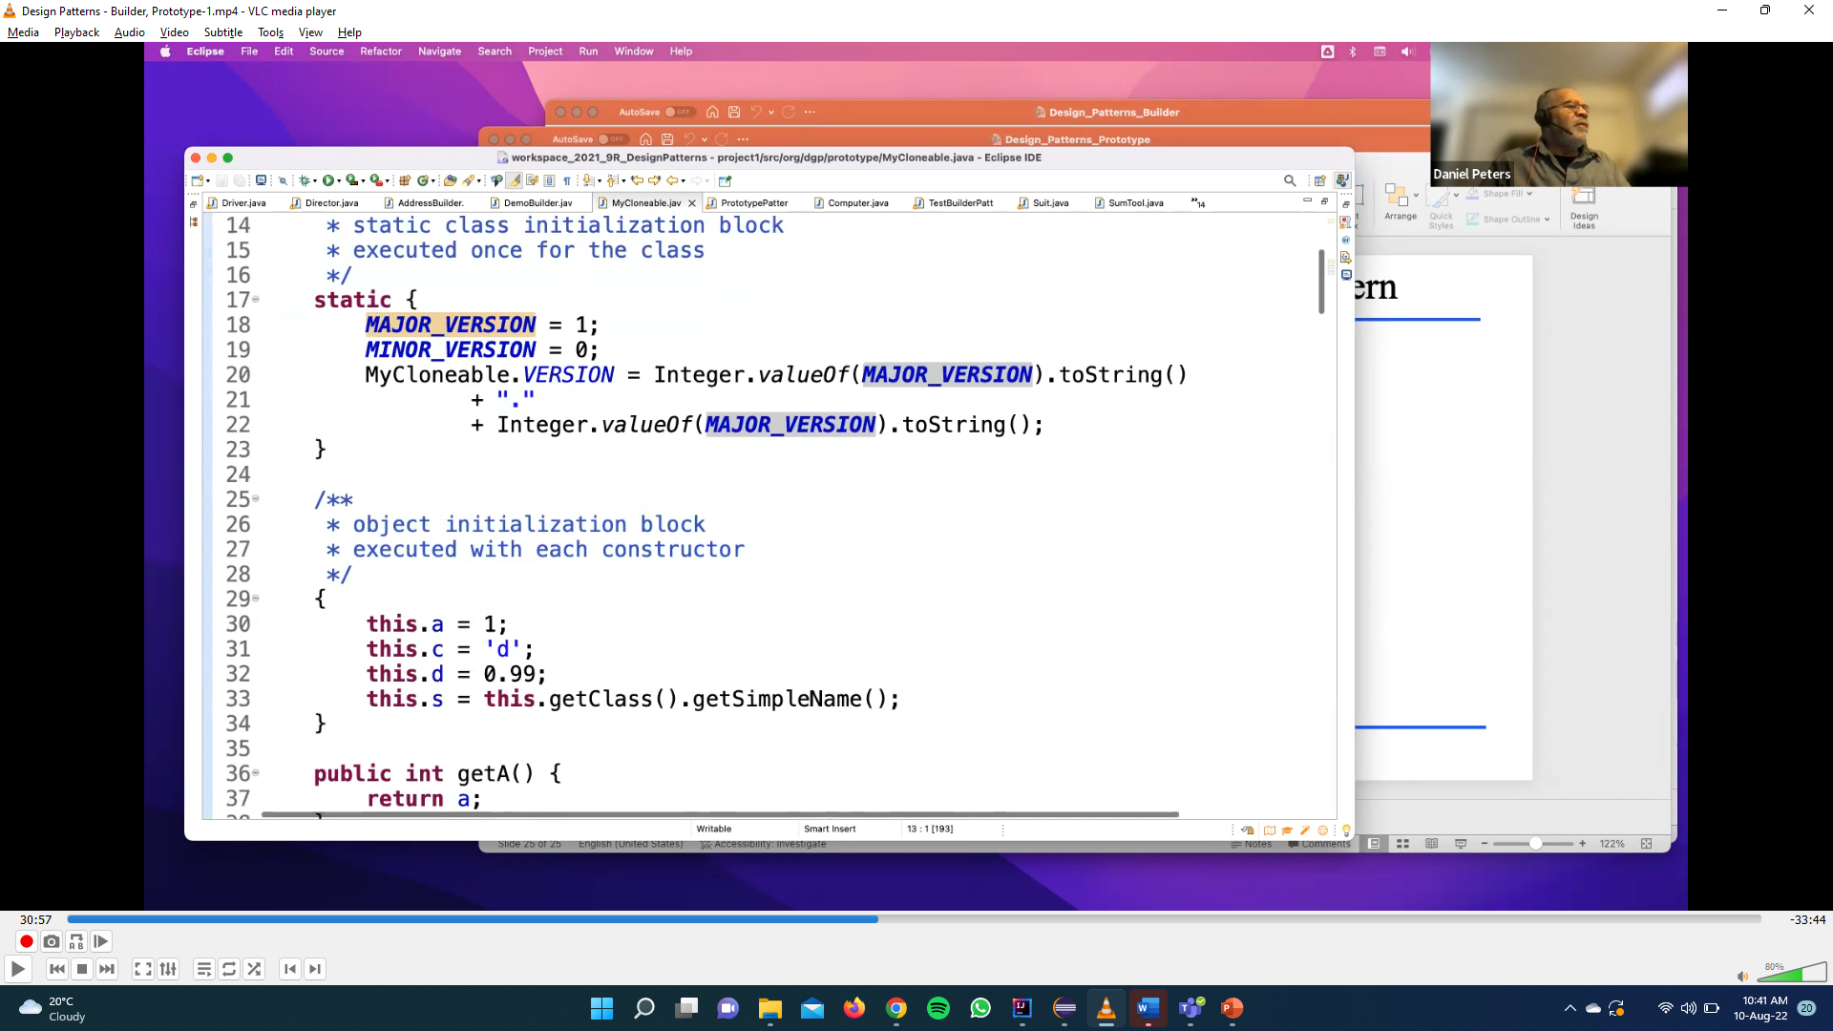
Prototype Code-2

Slide 28
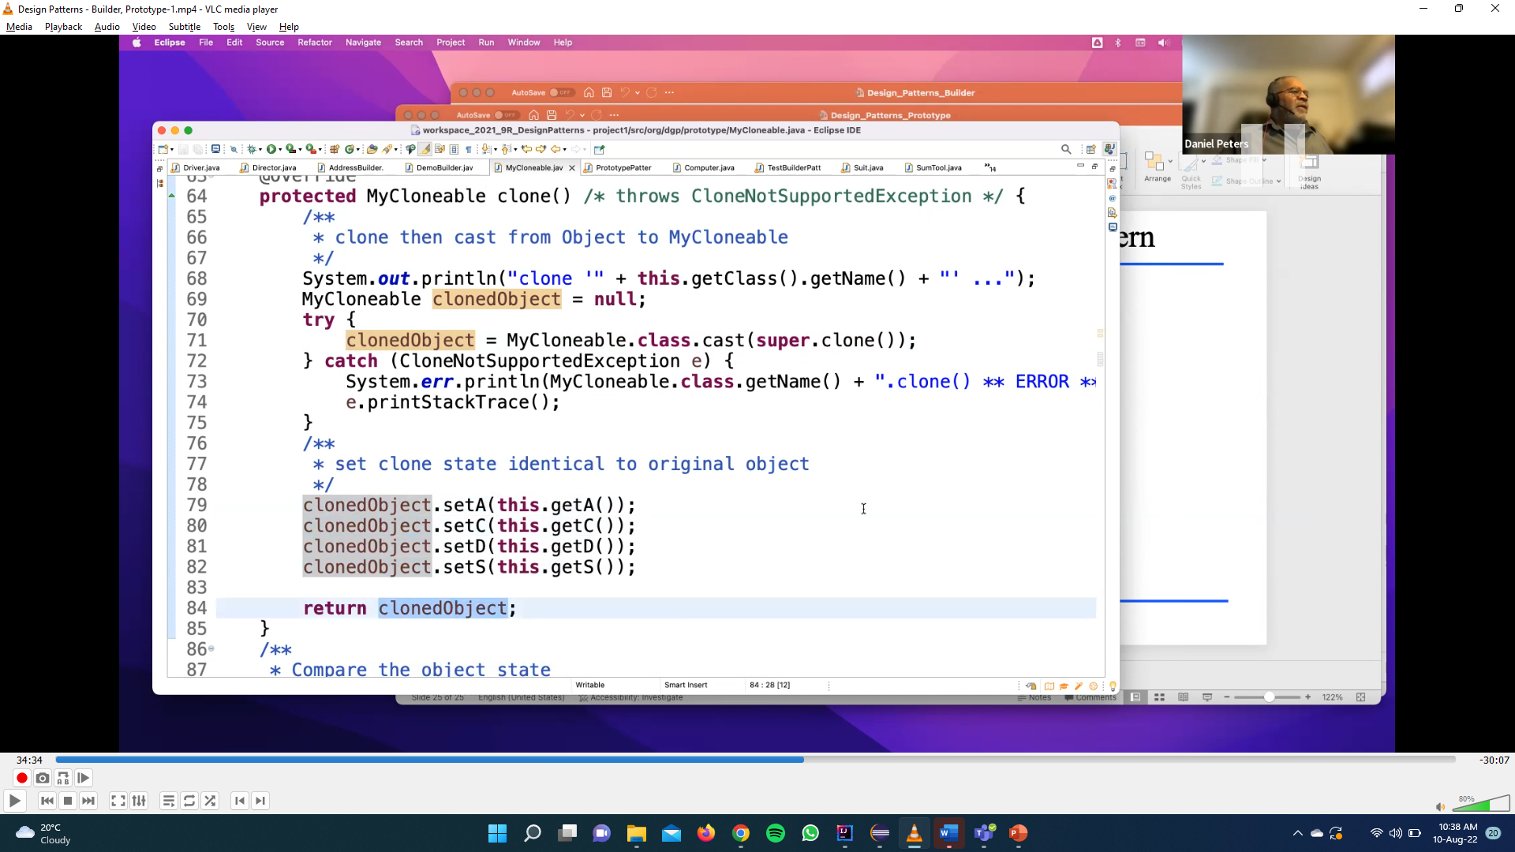
Prototype Code-2

Slide 29
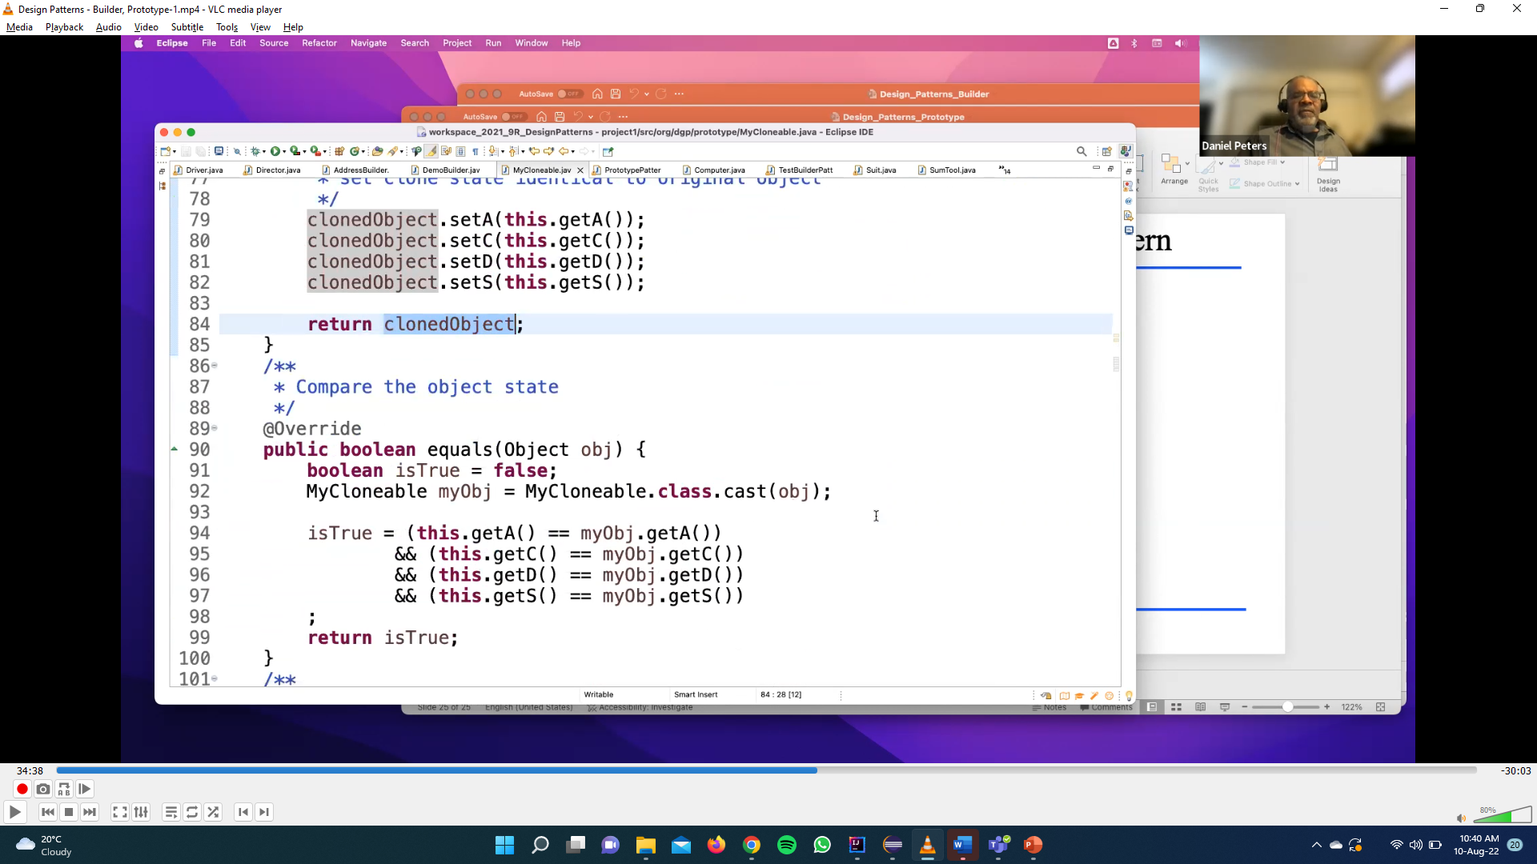
Prototype Code-2

Slide 31
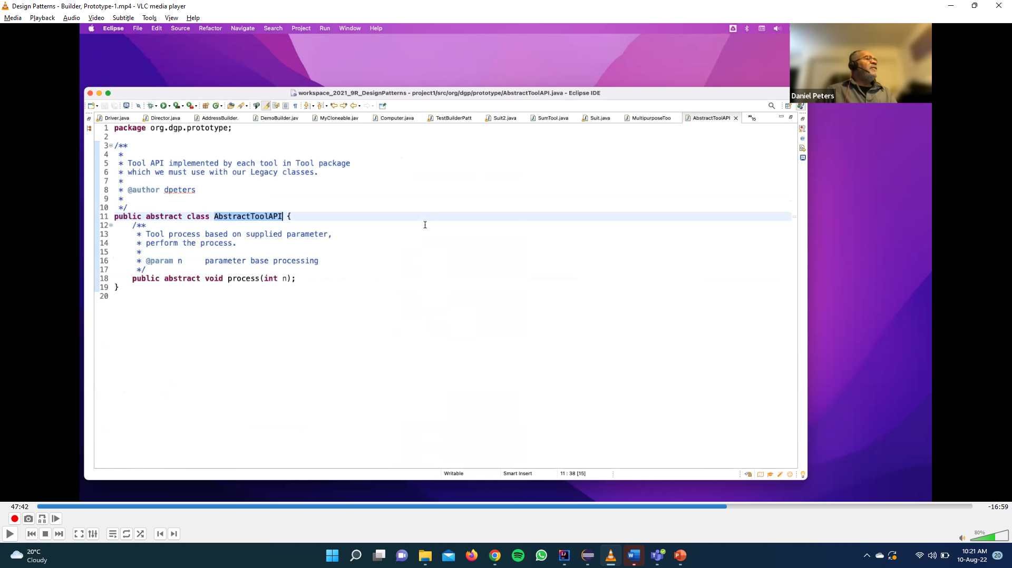
Prototype Code-1

Slide 32
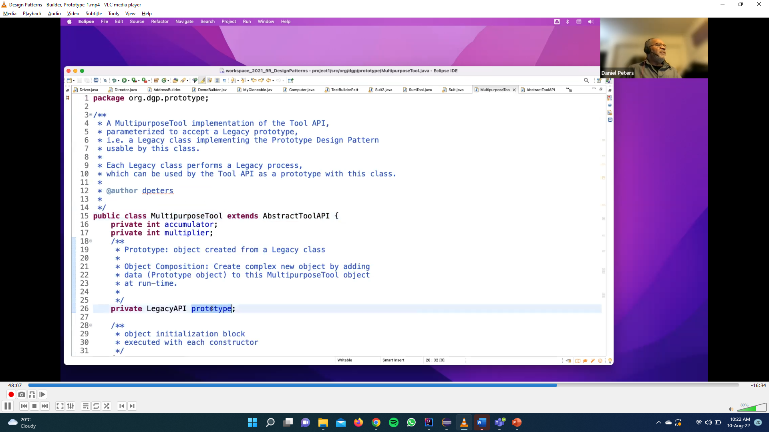
Prototype Code-1

Slide 33
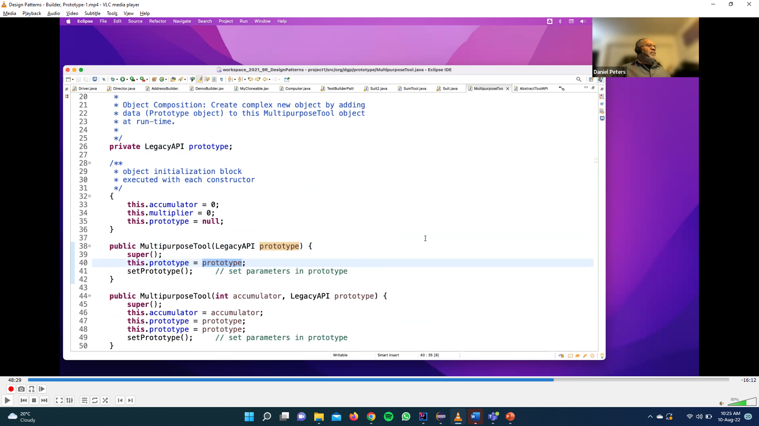
Prototype Code-1

Slide 34
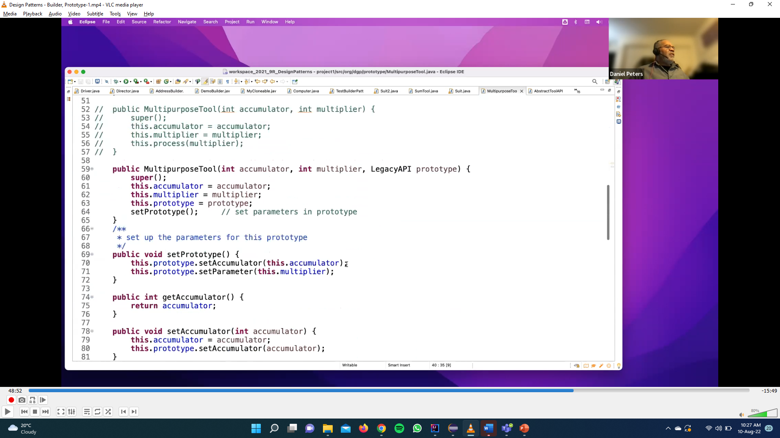
Prototype Code-1

Slide 35
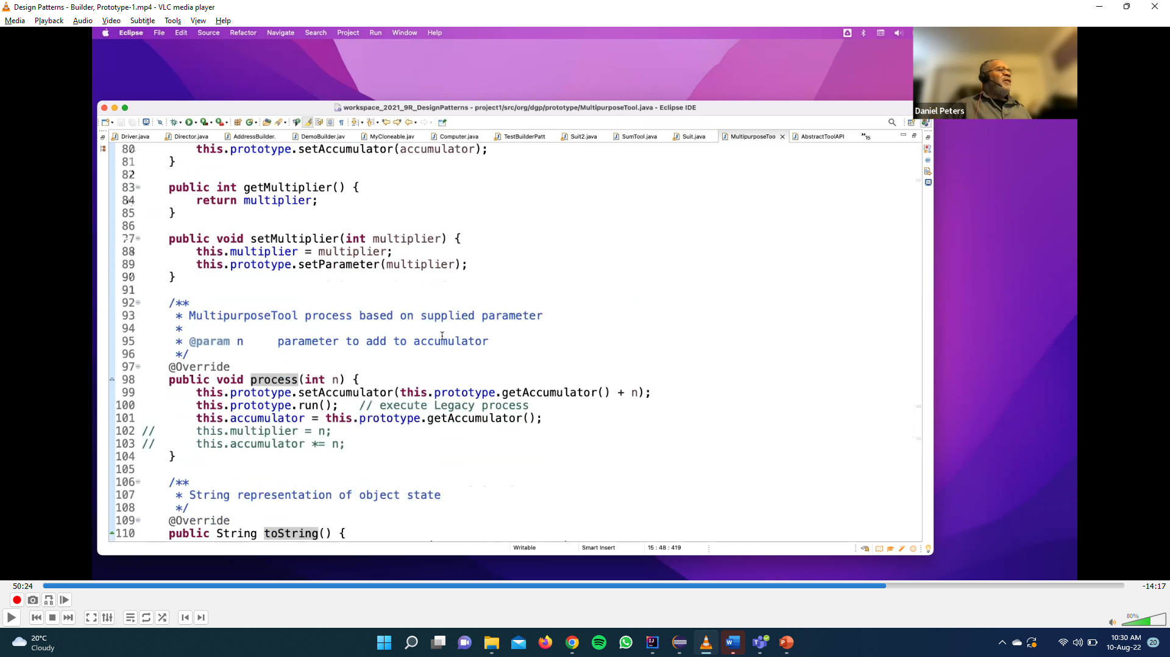
Prototype Code-1

Slide 36
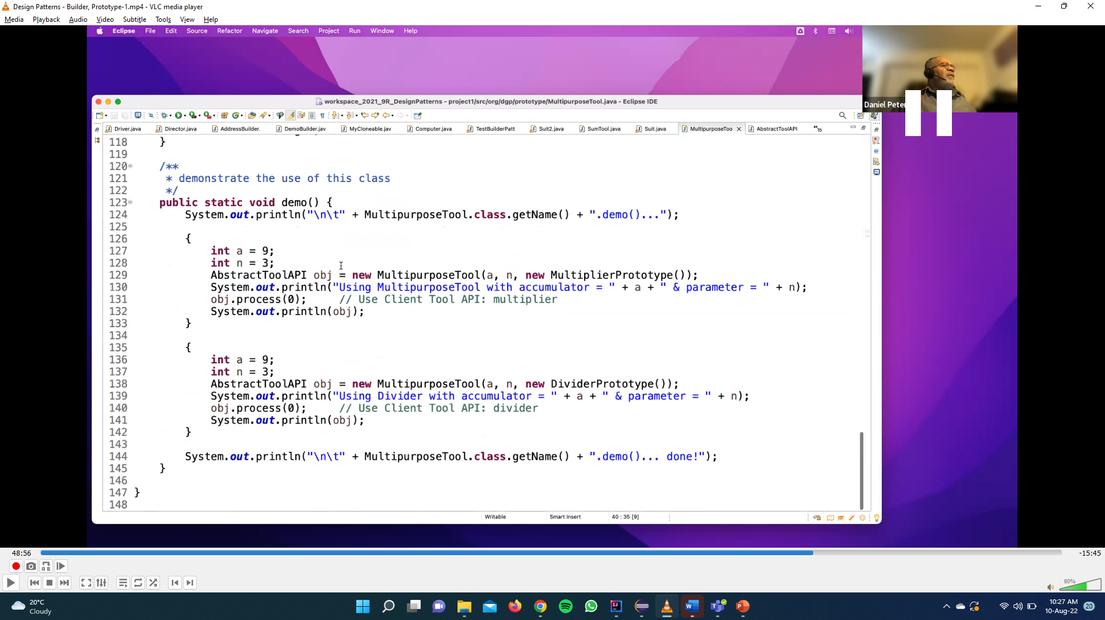
Prototype Code-1

Slide 37
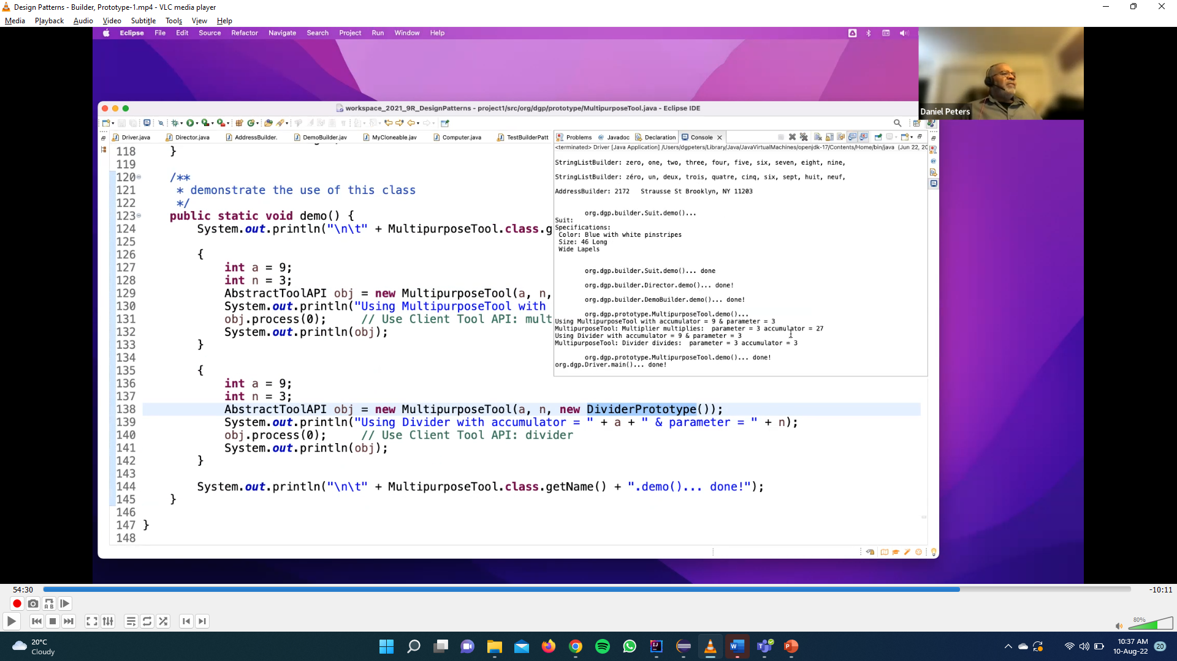
Prototype Code-1

Slide 38
Prototype Code-3

Slide 39
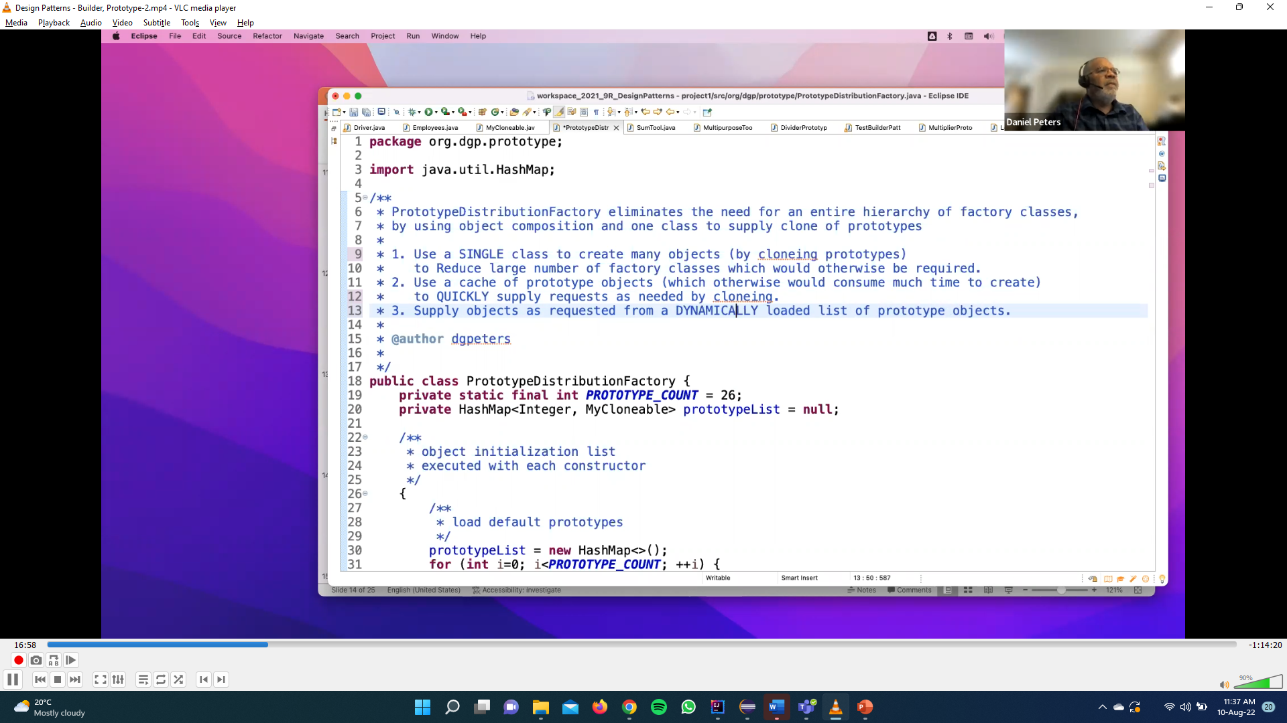
Prototype Code-3

Slide 40
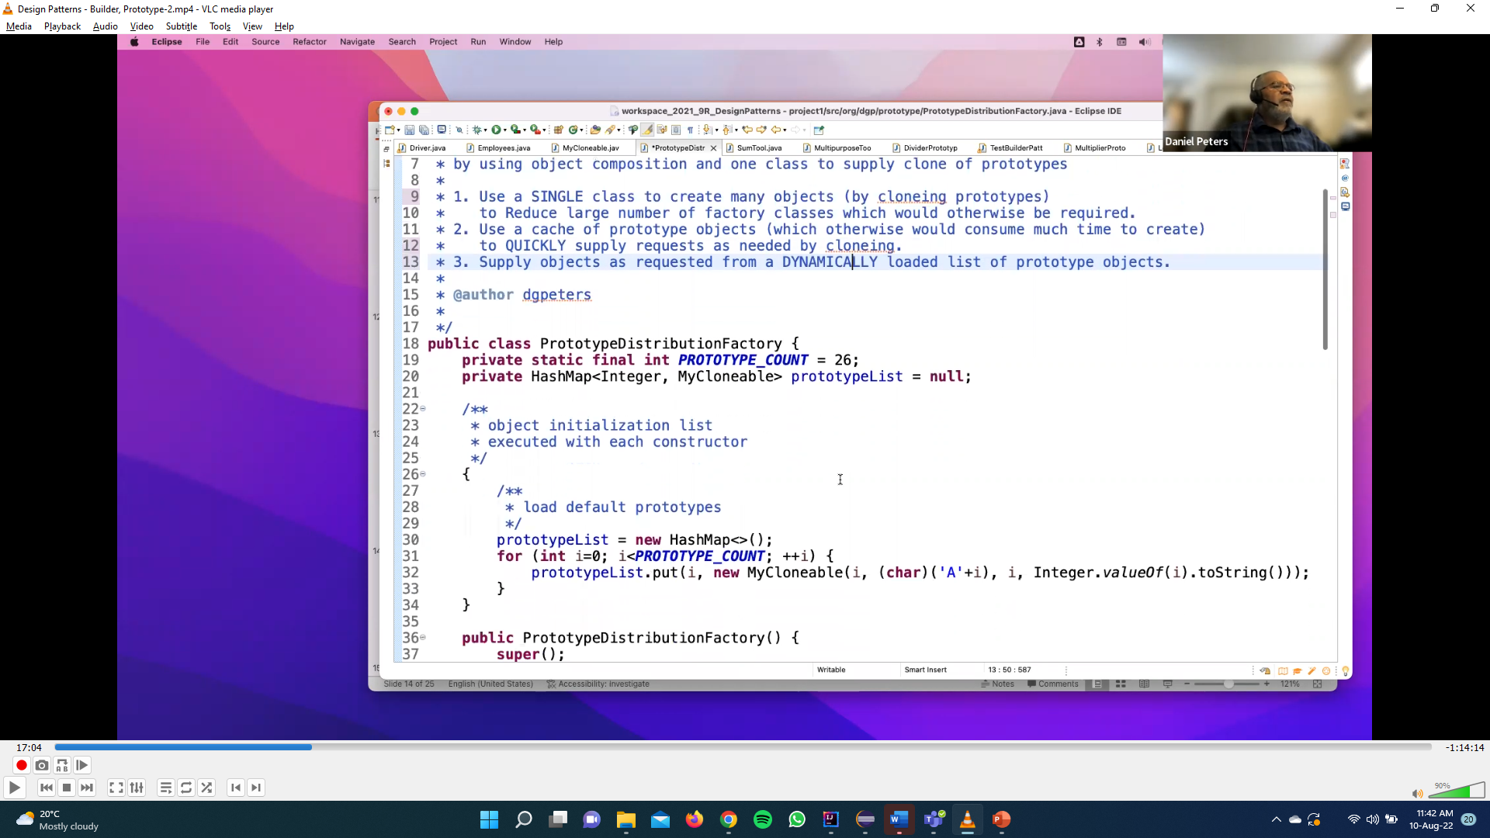

Slide 41
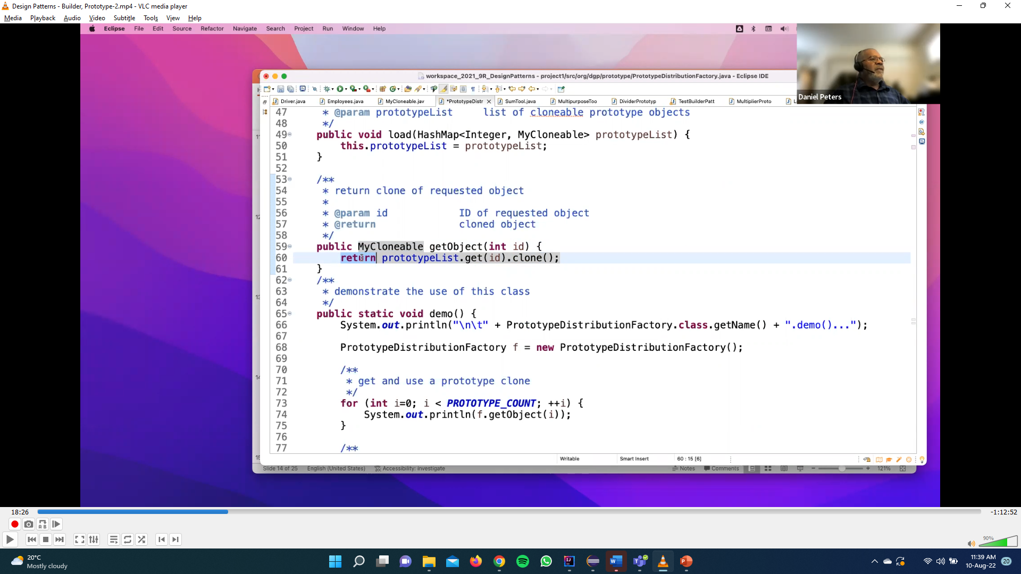

Slide 42
